Slide 1
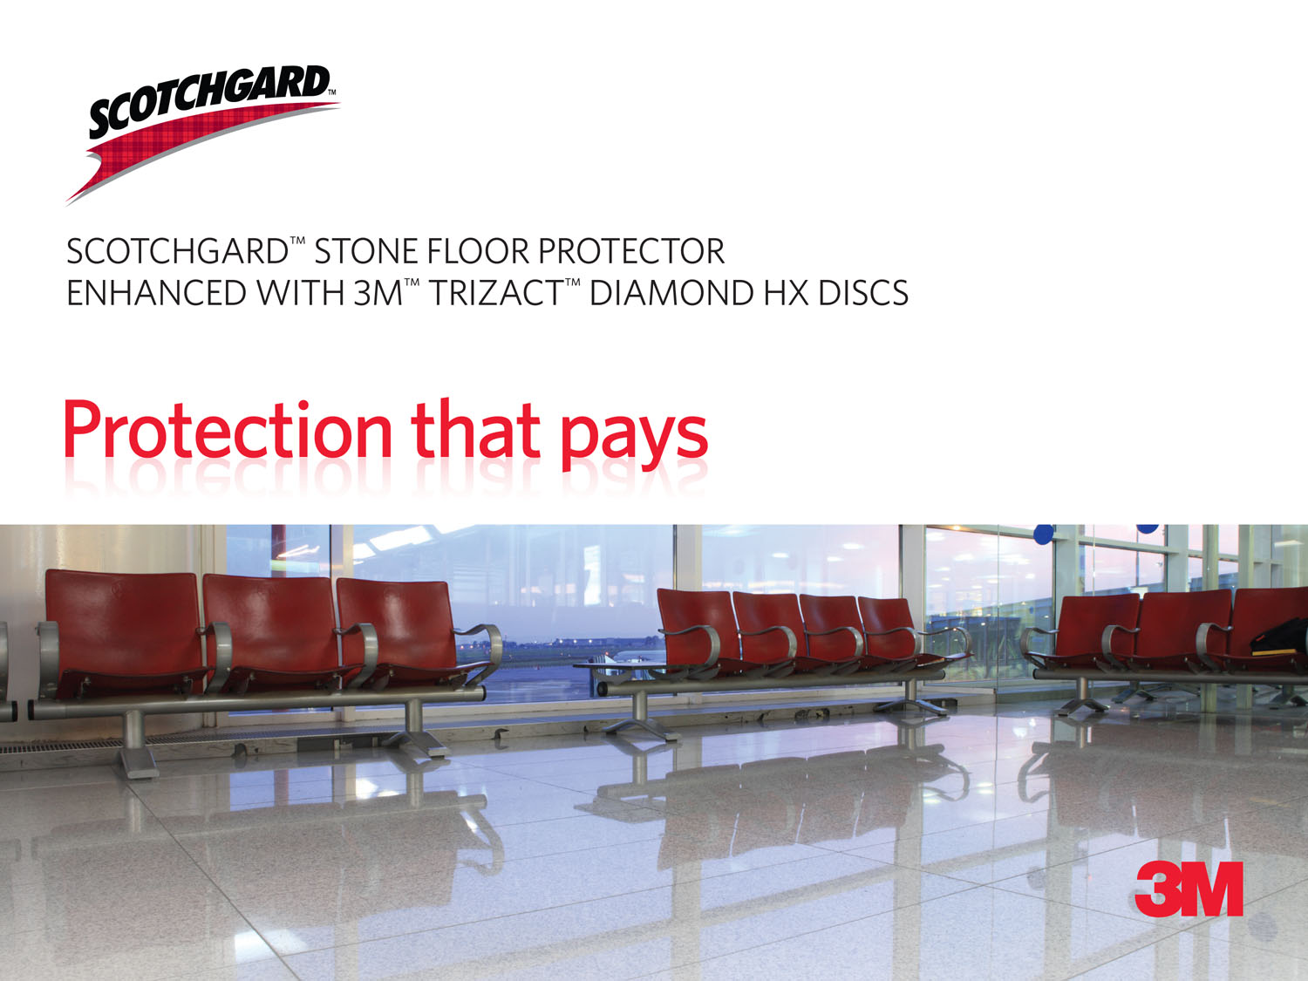

Slide 2
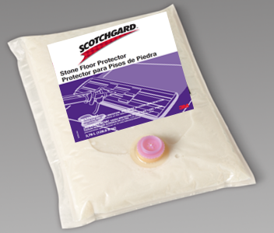
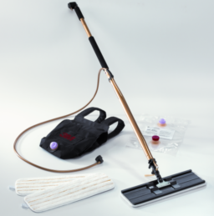
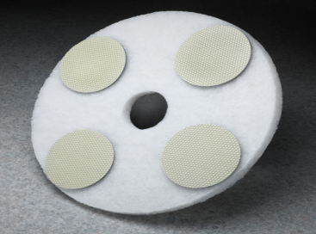
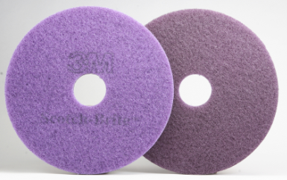
What is Scotchgard™ Stone Floor Protector?
Floor surface hardener and protective clear finish for concrete, marble, terrazzo, and other porous stone surfaces and has an excellent stain, scuff and scratch resistance
  Utilizes inorganic particles to form a very hard surface
  Reduced maintenance and labor costs
    35%-60% savings vs traditional acrylic finishes
  2 coat application with 3M™ Easy Shine Applicator
  Uses our Scotch-Brite™ Diamond floor pads to “pop” gloss back
  20-30 minutes dry time per coat
  Medium gloss / high durability
    Traditional floor finishes have high gloss but low durability
  Does not need to be stripped or deep scrubbed

Slide 3
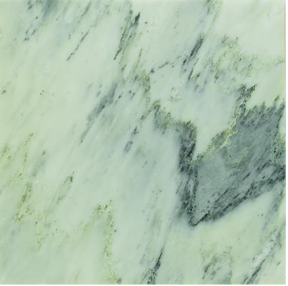


Suitable Surfaces
Polished Concrete
Terrazzo
Marble

Slide 4
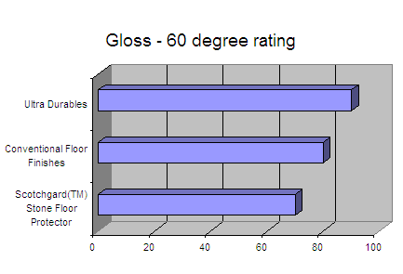
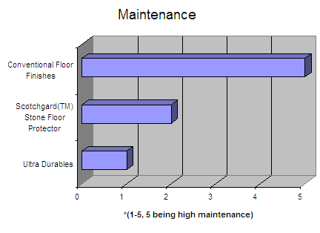
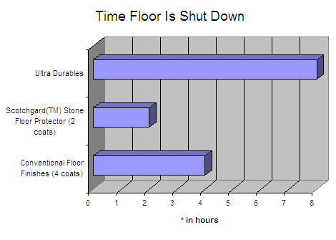
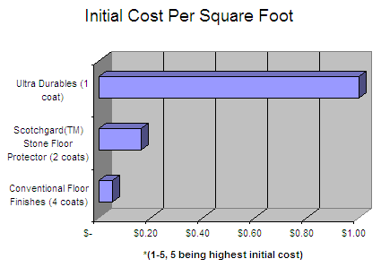
How does it compare to other coatings?
* Charts are for comparison purposes only

Slide 5
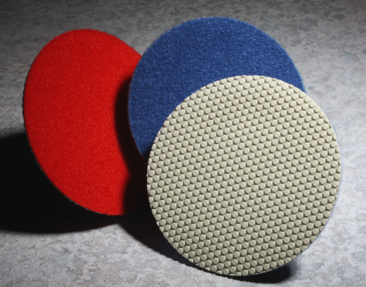
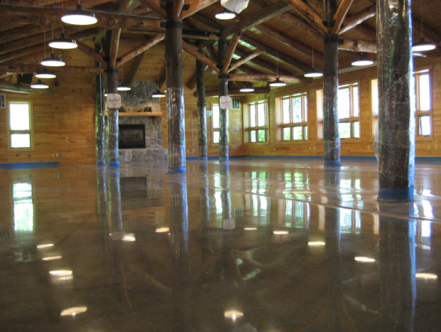
3M™ Trizact™ Diamond HX Discs
Designed for use with the Scotchgard™ Stone Floor Protector System, 3M™ Trizact™ Diamond HX Discs can help turn your dull and scratched stone floors into beautiful and shiny floors.
  Recommended for older stone floors or floors that higher gloss is desired
Used to hone and refinish most stone surfaces including concrete, marble, and terrazzo
3 grades available to tackle a variety of floor conditions

Slide 6
3M™ Trizact™ Diamond HX Discs
Consist of precisely-patterned, composite abrasive structures distributed uniformly on a flexible backing.
As these structures wear, fresh, sharp diamond abrasive is continually exposed, resulting in uniform, consistent and fast cutting action through the life of the product.
  Due to the unique properties of the proprietary design characteristics of 3M™ Trizact™ Abrasives, fewer abrasive steps are required when compared to traditional floor grinding and polishing.
Each of the 3M™ Trizact™ Diamond HX Discs will typically replace several grits of commonly used diamonds.

Slide 7
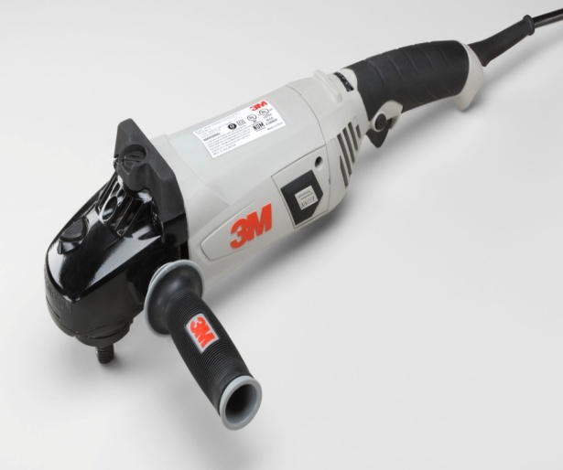
3M™ Trizact™ Diamond HX Discs
Attach to standard floor pads for use on low speed equipment such as buffers or automatic scrubbers
Can also be used on the 3M™ Electric Variable Speed Polisher for stairs, corners, and other tight spaces

Slide 8
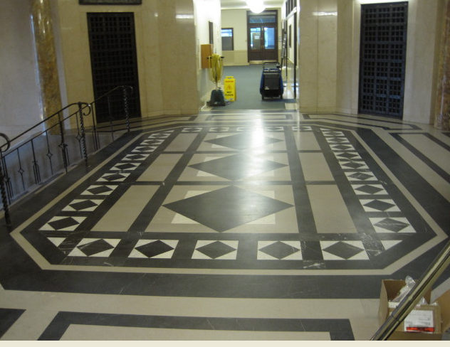
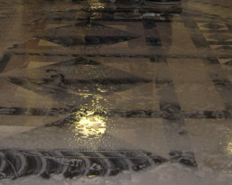
Before and After Pictures
Initial
Using 3M™ Trizact™ Diamond HX Discs

Slide 9
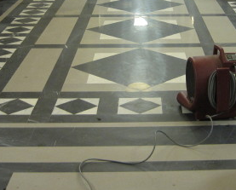
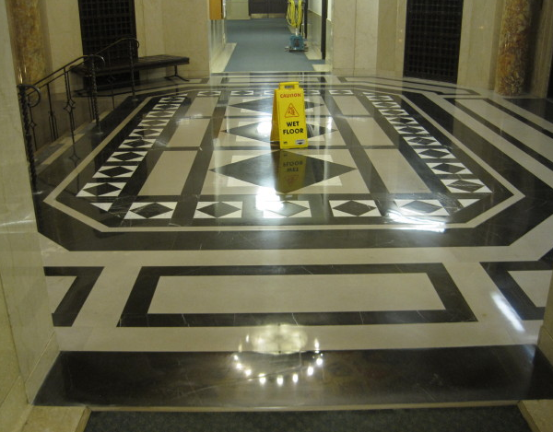
Before and After Pictures
After 3M™ Trizact™ Diamond HX Discs
Finished Scotchgard™ Stone Floor Protector

Slide 10
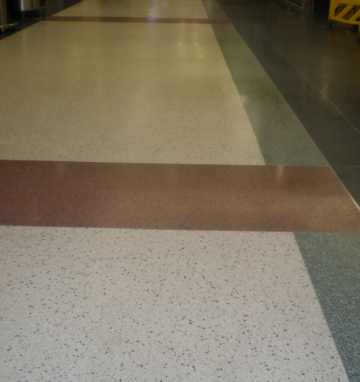
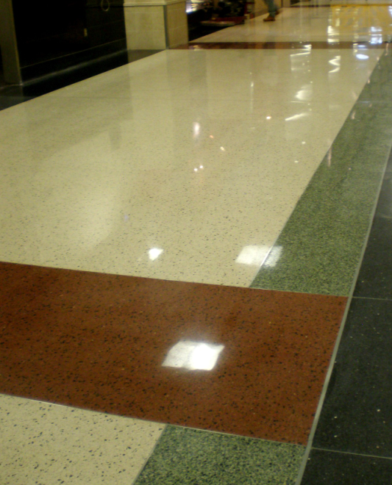
Before and After Pictures
Initial
After

Slide 11

Customer Payback Tool

Slide 12

Instructional Video

Slide 13
Initial Application
Strip all old finish or other coatings from floor using a 3M™ floor stripper and a 3M™ stripping pad. Rinse and allow floor to dry thoroughly. (3M™ Scotch-Brite™ Hi Production Stripping Sheets work well on concrete and terrazzo)
If floor has deep scratches or pitting, use the 3M™ Trizact™ Diamond HX Discs. Otherwise, skip to step:
Attach four 3M™ Trizact™ Diamond HX Disc Gold (gold/orange backing) to a 3M™ White Super Polish Pad 4100 in the 12:00, 3:00, 6:00 and 9:00 positions.
Make 4 passes with the 3M™ Trizact™ Diamond HX Disc Gold with squeegee up and solution on. 5th pass should be with squeegee down. 6th pass with squeegee up and solution on. (6 total passes)

Slide 14
Initial Application
If 3M™ Trizact™ Diamond HX Disc Gold were used, make 2 passes with the 3M™ Trizact™ Diamond HX Red with squeegee up and solution on. 3rd pass should be with squeegee down. 4th pass with squeegee up and solution on. (4 total passes)
  If 3M™ Trizact™ Diamond HX Disc Gold were not used, make 4 passes with the 3M™ Trizact™ Diamond HX Disc Red with squeegee up and solution on. 5th pass should be with squeegee down. 6th pass with squeegee up and solution on. (6 total passes)
Make 5 passes with the 3M™ Trizact™ Diamond HX Disc Blue with squeegee up and solution on. 6th pass should be with squeegee down.
Clean the floor with autoscrubber and water using the 3M™ Red Buffer Pad 5100 to remove any remaining residue.

Slide 15
Initial Application
Make 4 passes using a burnisher and the Scotch-Brite™ Purple Diamond Floor Pad Plus.
Dust the floor using the 3M™ Easy Trap Duster.
Wet the 3M™ Easy Shine Applicator Pad with the Scotchgard™ Stone Floor Protector and then apply a thin, uniform coat of Scotchgard™ Stone Floor Protector to the floor using the 3M™ Easy Shine Applicator System. Allow 15 to 30 minutes of drying time. Burnish the floor 6 times with the Scotch-Brite™ Purple Diamond Floor Pad Plus.
Dust the floor using the 3M™ Easy Trap Duster. Apply a second thin, uniform coat of Scotchgard™ Stone Floor Protector using the 3M™ Easy Shine Applicator System. Allow 15 to 30 minutes of drying time. Burnish the floor again 6 times using the Scotch-Brite™ Purple Diamond Floor Pad Plus.

Slide 16
Maintenance
Dust mop, damp mop or machine scrub as necessary.
For optimum appearance, auto scrub with the 3M™ Neutral Cleaner Concentrate 3L/3H (for use with the 3M™ Twist ‘n Fill™ Chemical Management System) and Scotch-Brite™ Purple Diamond Floor Pad Plus
When appearance of floor begins to dull, burnish the floor using the Scotch-Brite™ Purple Diamond Floor Pad (typically one to two times per month).
Recoat traffic areas or entire floor as necessary with Scotchgard™ Stone Floor Protector using the 3M™ Easy Shine Applicator System. Be sure floor is clean and free of marks before recoating (typically one to two times per year). Using the 3M™ Blue Cleaner Pad 5300 with 3M™ Neutral Cleaner Concentrate 3L/3H (for use with the 3M™ Twist ‘n Fill™ Chemical Management System) will properly prepare the floor for recoating.

Slide 17
Typical Maintenance Requirements
Customer Type | Hospital / School | Retail
Traffic Levels | Medium | High
# of Coats on Initial Application | 2 | 2
Burnishing Frequency | 1x/month | 1-2x/month
Refresher Coat | 1x/yr | 1-2x/yr

Slide 18

3M™ Electric Variable Speed Polisher
Designed for use on stairs, corners, and other tight spaces
11 Amp motor delivers 37.5% more power.*
More control. Maintain speed and power under load with 1,000 - 3,000 rpm variable speed control.
More comfort. 3M gripping material and vibration-absorbing handle improve comfort.
More durability. Solid, lightweight construction with an extra-long and extra strong power cord.
*Compared to polishers with an 8 Amp motor.

Slide 19
How to Use
Step 1: Using the 3M™ Trizact™ Diamond HX Gold Disc, make 6 overlapping passes
  Surface should have adequate water to generate slurry
Step 2: Wipe up slurry, add fresh water to surface and make 4 overlapping passes with 3M™ Trizact™ Diamond HX Red Disc
Step 3: Wipe up slurry, add fresh water to surface and make 6 overlapping passes with 3M™ Trizact™ Diamond HX Blue Disc
*Use proper protective gloves and eyewear

Slide 20
How to Use
Step 4: Wipe up slurry and clean surface. Make 4 overlapping passes with Scotch-Brite™ Purple Diamond Floor Pad Plus
Step 5: Dust surface with 3M™ Easy Trap Duster and apply Scotchgard™ Stone Floor Protector
  Make 6 overlapping passes with Scotch-Brite™ Purple Diamond Floor Pad Plus after each coat
*Use proper protective gloves and eyewear

Slide 21
Tools
Literature
  Sales Brochure
  FAQs
ROI / Investment Calculator
Video
  www.3mfloorprotection.com
Technical Data Sheet – System components, instructions for use, and more

Slide 22
Frequently Asked Questions

Slide 23
Frequently Asked Questions - FAQs
Is Scotchgard™ Stone Floor Protector green?
  This product system meets Executive Order 13423 definition of “Environmentally Preferable.”
  Helps reduce the need for finishes, strippers and crystallization products, and the labor intensive work associated with applying these chemical products
  *Environmentally Preferable Products are defined in the Instructions for Implementing Executive Order
  13423, titled “Strengthening Federal Environmental, Energy, and Transportation Management” as
  products or services that have a lesser or reduced effect on human health and the environment when
  compared with competing products or services that serve the same purpose. This comparison may
  consider raw materials acquisition, product, manufacturing, packaging, distribution, reuse, operation,
  maintenance, or disposal of the product or service.

Slide 24
Frequently Asked Questions - FAQs
How do I remove the Scotchgard™ Stone Floor Protector from the floor?
  If you would like to remove the product from the floor and recoat again, the Scotch-Brite™ Surface Prep Pad with water or neutral cleaner will prepare the floor adequately for recoating with Scotchgard™ Stone Floor Protector. If you would like to remove it completely and recoat with a traditional, acrylic floor finish, use a 3M™ floor stripper and a 3M™ stripping pad. Rinse and allow floor to dry thoroughly.
Will Scotchgard™ Stone Floor Protector discolor stone / concrete floors?
  The Scotchgard™ Stone Floor Protector may slightly darken some floors. Due to the fact that it also increase the gloss of the floor, it will show or enhance the subtle colors found in many floors that may have not been visible before if the floor was uncoated or coated with a traditional, acrylic floor finish.

Slide 25
Frequently Asked Questions - FAQs
What precautions do you need to take the first 24 hours after applying this product?
  The first 24 hours is critical to avoid standing water. There are no restrictions from using an auto scrubber or microfiber flat mop, but standing water can be problematic.
  Floor can be opened to traffic when dry to the touch (20-30 minutes after application)
Are there certain cleaning chemicals that should not be used on this product?
  Butyl (also known as 2-Butoxyethanol) or d-limonene containing products should not be used on this product.
  Butyl is commonly found in Floor Strippers, Surface Emulsifier / Extenders, and Degreasers

Slide 26
Frequently Asked Questions - FAQs
What “grade” are 3M™ Trizact™ Diamond HX Discs?
  3M™ Trizact™ Diamond HX Discs are not specified by a grade designation. The abrasive actions of the 3M™ Trizact™ Diamond HX Discs are classified as follows:
Product | Grade Designation
3M™ Trizact™ Diamond HX Discs Gold | Coarse
3M™ Trizact™ Diamond HX Discs Red | Medium
3M™ Trizact™ Diamond HX Discs Blue | Fine

Slide 27
Frequently Asked Questions - FAQs
What “grade” are 3M™ Trizact™ Diamond HX Discs? (continued)
  Due to the proprietary design characteristics of 3M™ Trizact™ Abrasives, fewer abrasive steps are required when compared traditional floor grinding and polishing abrasives
  Each of the 3M™ Trizact™ Diamond HX Discs will typically replace several grades of conventional diamond abrasives
Traditional Diamond Discs | 3M™ Trizact™ Diamond HX Discs
ANSI 60, 80, 100 grit | 3M™ Trizact™ Diamond HX Discs Gold
ANSI 100, 120, 180, 220, 240, 320, 400 grit | 3M™ Trizact™ Diamond HX Discs Red
ANSI 400, 600, 1000, 1200 grit | 3M™ Trizact™ Diamond HX Discs Blue

Slide 28
Frequently Asked Questions - FAQs
When do I use 3M™ Trizact™ Diamond HX Discs Gold?
  The 3M™ Trizact™ Diamond HX Discs Gold should be used there is apparent wear, or visible damage on the floor. Such damage might be caused by pitting from action of ice-melting agents or other chemicals. Scratches can occur by abrasion from movement of pallets or other heavy items, heavy foot traffic, or any other physical wear of the floor surface

Slide 29
Frequently Asked Questions - FAQs
Do I have to use the 3M™ Trizact™ Diamond HX Discs in sequence starting with 3M™ Trizact™ Diamond HX Discs Gold and finishing with 3M™ Trizact™ Diamond HX Discs Red and Blue?
  3M™ Trizact™ Diamond HX discs should ALWAYS be used in the order GOLD – RED - BLUE. Follow final polishing by burnishing with the Scotch-Brite™ Purple Diamond Floor Pad Plus and applying Scotchgard™ Stone Floor Protector.
  Depending on the floor condition, use of the 3M™Trizact™ Diamond HX Discs Gold as the first step is optional to quickly remove surface scratches and other damage before going on to the normal Red / Blue / Purple sequence.

Slide 30
Frequently Asked Questions - FAQs
Do 3M™ Trizact™ Diamond HX Discs require any break-in before use?
  Usually, new discs become “conditioned” or “worn-in” within the first pass on the recommended multi-pass sequence.
  Break-in can be speeded up by rubbing the 3M™Trizact™ Diamond HX Discs by hand on a rough surface (e.g. a concrete wall or floor) to remove the thin skin of resin on the top of the as-produced discs.
How long will they last?
  3M™ Trizact™ Diamond HX Disc life depends critically on use factors such as flooring type and condition, machine pressure and speed.
  Terrazzo: estimate 5000 FINISHED sq ft (5000 ft x 6 passes = 30,000 sq ft TOTAL)
  Concrete: due to variability in starting surface condition, estimate ~1000 sq ft finished (1000 ft x 6 passes = 6000 sq ft TOTAL)

Slide 31

Caution: Some floors may release dust that could be hazardous to the user or bystanders. Eye, skin and/or respiratory personal protection equipment may be appropriate to reduce the risks associated with exposure to airborne dust.
Product Use: All statements, technical information and recommendations contained in this document are based on tests or experience that 3M believes are reliable. However, many factors beyond 3M’s control can affect the use and performance of a 3M product in a particular application, including conditions under which the product is used and the time and environmental conditions in which the product is expected to perform. Since these factors are uniquely within the user’s knowledge and control, it is essential that the user evaluate the 3M product to determine whether it is fit for a particular purpose and suitable for the user’s method of application.
Warranty and Limited Remedy: Unless stated otherwise in 3M’s product literature, packaging inserts or product packaging for individual products, 3M warrants that each 3M product meets the applicable specifications at the time 3M ships the product. Individual products may have additional or different warranties as stated on product literature, package inserts or product packages. 3M MAKES NO OTHER WARRANTIES, EXPRESS OR IMPLIED, INCLUDING BUT NOT LIMITED TO, ANY IMPLIED WARRANTIES OF MERCHANTABILITY OR FITNESS FOR A PARTICULAR PURPOSE OR ANY IMPLIED WARRANTY ARISING OUT OF A COURSE OF DEALING, CUSTOM OR USAGE OF TRADE. User is responsible for determining whether the 3M product is fit for a particular purpose and suitable for user’s application. If the 3M product is defective within the warranty period, your exclusive remedy and 3M’s and seller’s sole obligation will be, at 3M’s option, to replace the product or refund the purchase price.
Limitation Of Liability: Except where prohibited by law, 3M and seller will not be liable for any loss or damage arising from the 3M product, whether direct, indirect, special, incidental, or consequential regardless of the legal theory asserted, including warranty, contract, negligence or strict liability.
Building and Commercial
Services Division
3M Center
St. Paul, MN 55144-1000
1-800-698-4595
www.3M/Building
© 3M 2011. All rights reserved Scotchgard, Scotch-Brite, Twist ‘n Fill
10/2011 Version A Trizact and the Plaid Design are trademarks of 3M,

